Slide 1
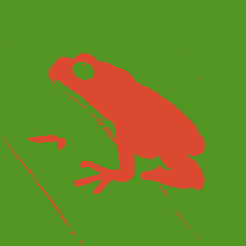
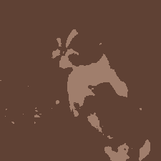
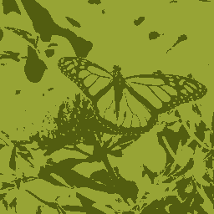
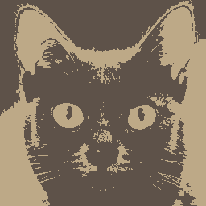
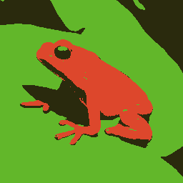
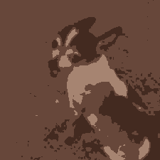
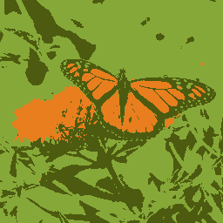
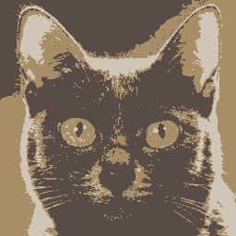

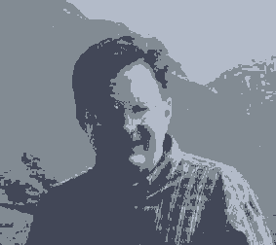

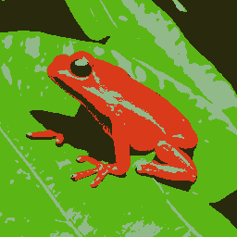
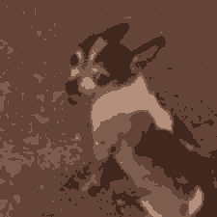
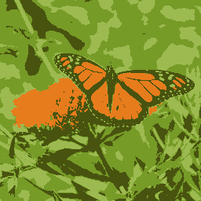
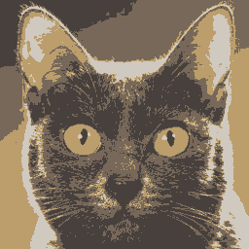



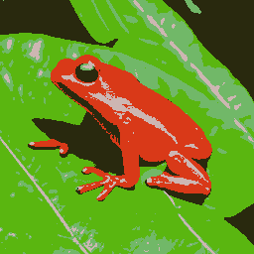
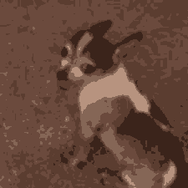
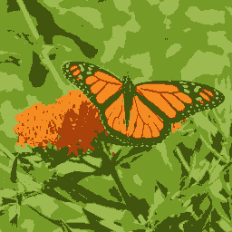
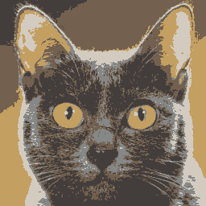
K-Means Clustering: Reducing Image Color-Space
Charles Chua
CSE 4643: AI
Dr. Eric Hansen
December 5th, 2023

Slide 2
We want to reduce the image to a certain number of colors, k
To achieve this, we need to find k colors which best represent the colors in the image
How do we find these representative colors?
K=1
K=2
K=3

Slide 3
K-Means clustering
Form of unsupervised learning for classifying objects into k classes
For our purposes, each pixel is an object
Classify pixels based on color value
Pick k random points in RGB color space – these are our centroids
Label pixels closest to each centroid as part of its classification
Shift centroids to least-square distance of all points in classification
Continue until centroids stop moving, or we hit the iteration limit (almost never happens)

Slide 4


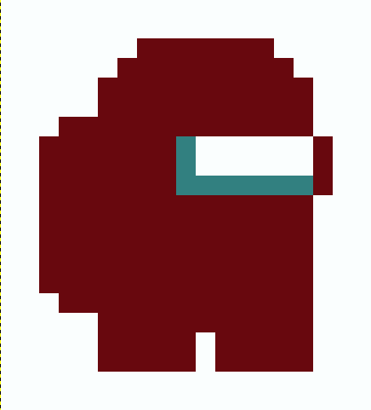
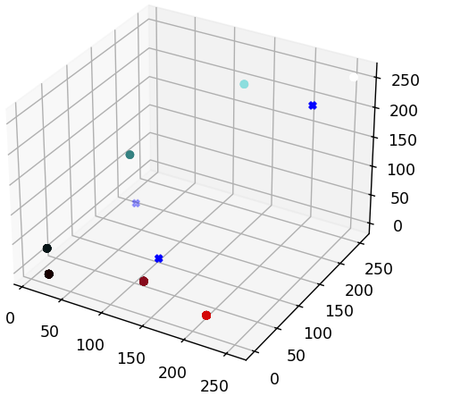
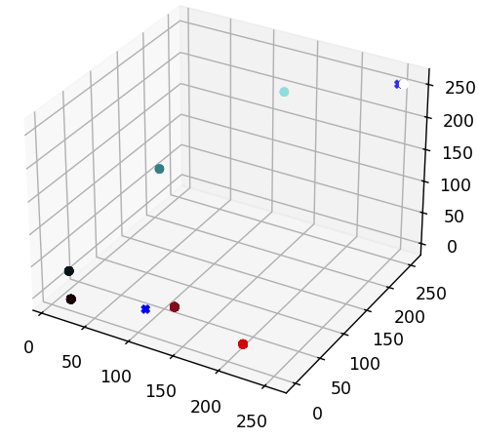
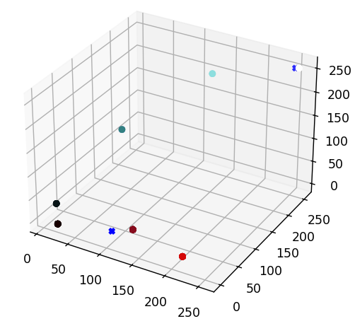
<- original image
1. Random Centroids
2. Adjustment
3. Final
Shift centroids to least-square distance of all points in classification
Shift centroids.
New centroids match previous, so this is our solution

Slide 5
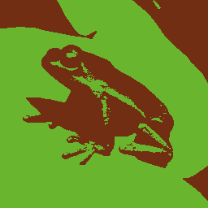

Solving the local minima problem
Depending on the starting centroids, k-means can converge on local minima
To solve this, we can run multiple iterations and calculate which one is the best
How do we calculate which one is “better”?

Slide 6
Original idea: Color distance
Calculate the average distance per pixel between the output and original image
Take the image with the least color image
This should result in a trend of lower average distance as we increase the number of colors, right?

Slide 7
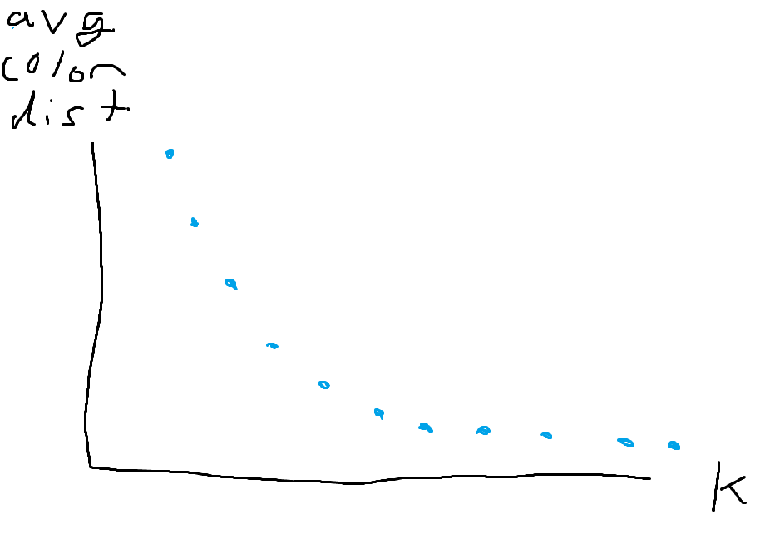
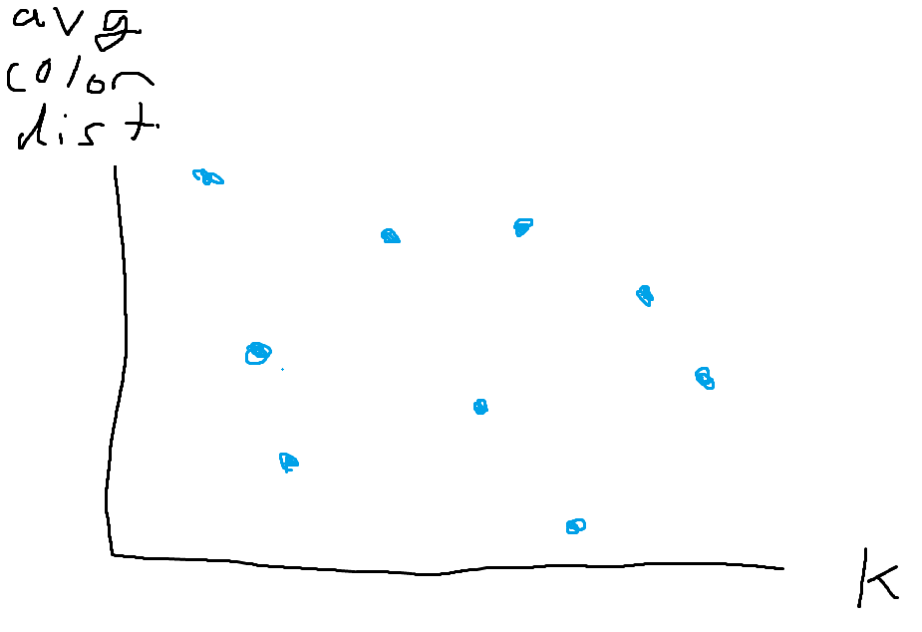
Nope! It is unreliable
Expected result:
Actual result:

Slide 8
New idea: Average of distances to nearest centroid
For each centroid, find the nearest other centroid
Add the distance to the nearest to a sum
Take the image with the highest distance between centroids

Slide 9
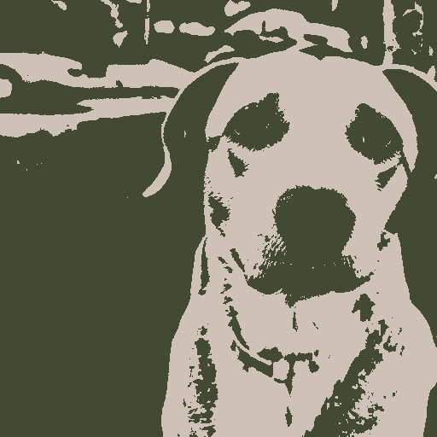
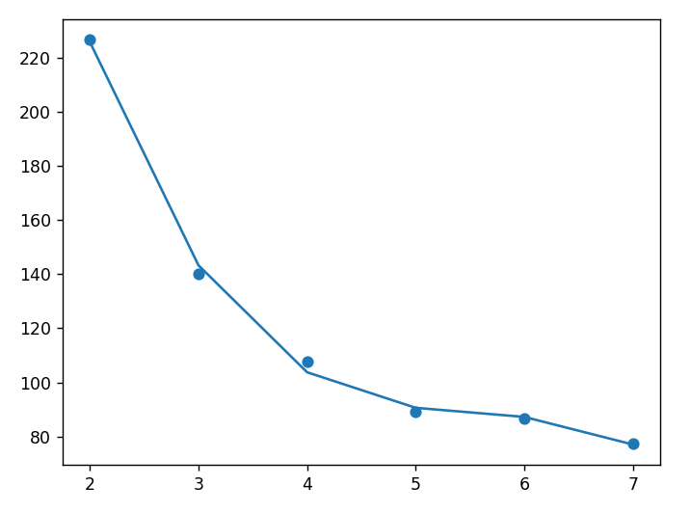
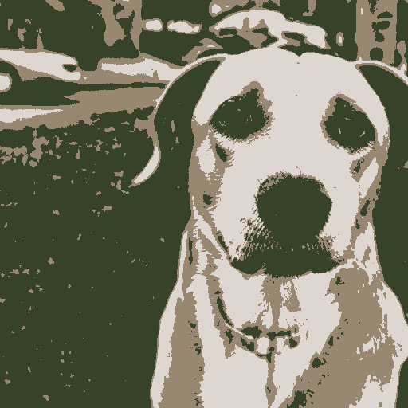
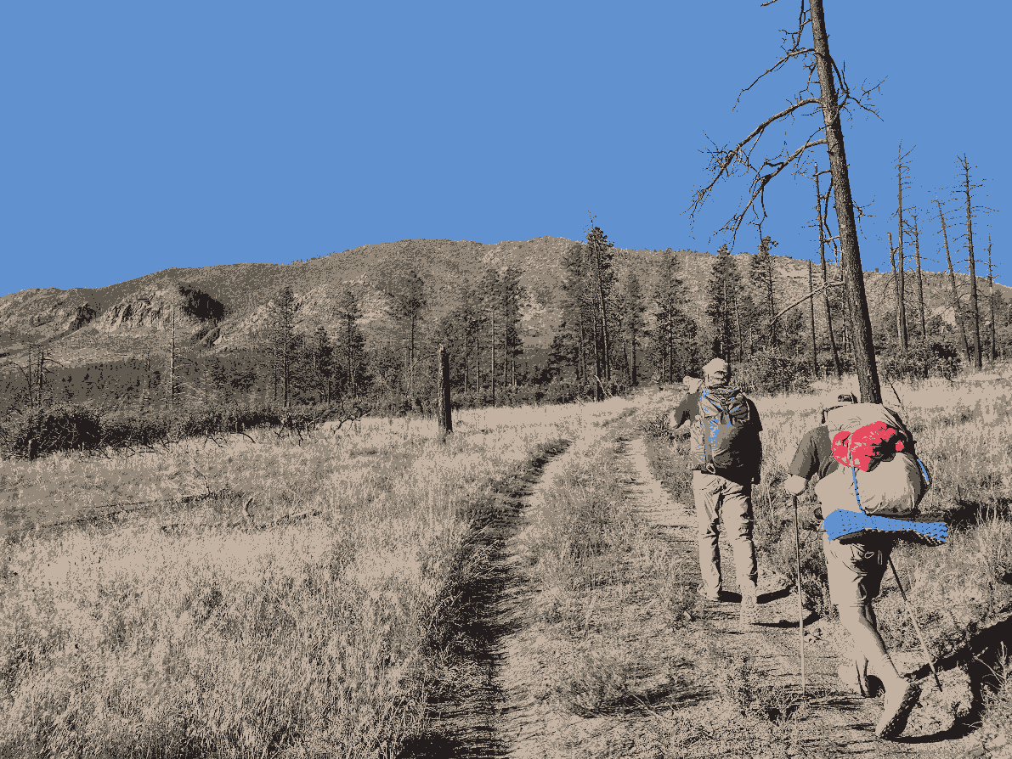
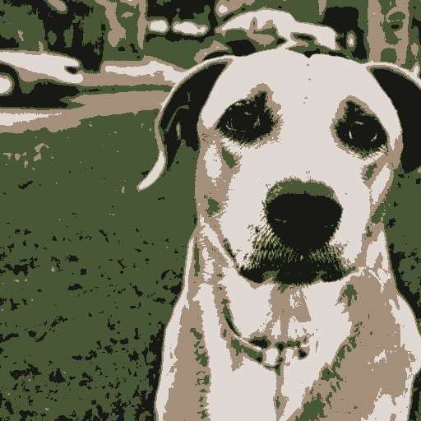
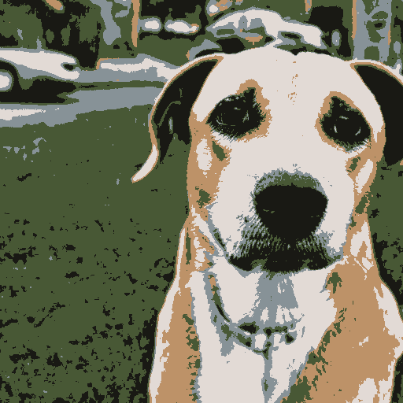
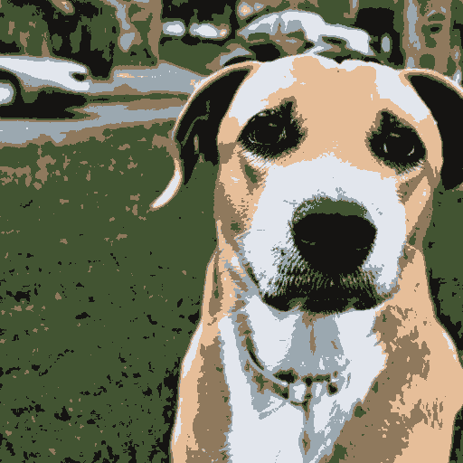
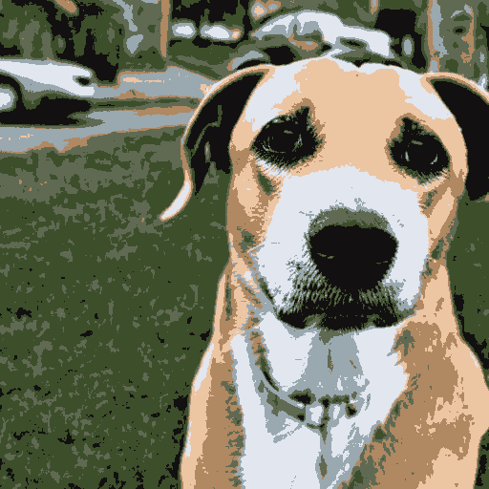
It works!
centroid neighbor distance avrg
This also has the benefit of prioritizing more unique colors (higher saturation)
dog2.png
K (# of colors)

Slide 10
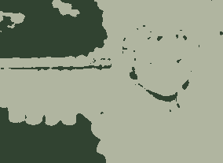
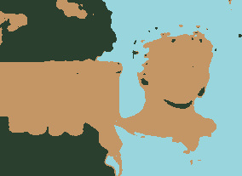
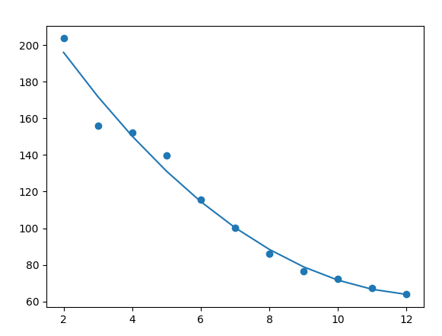
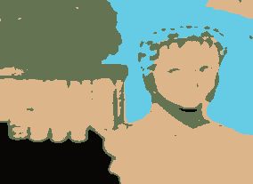
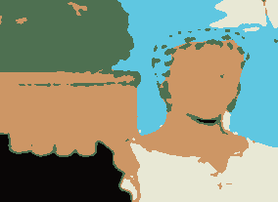
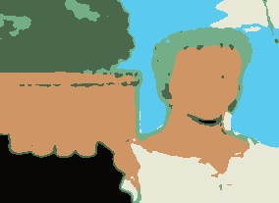
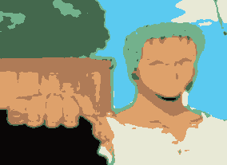
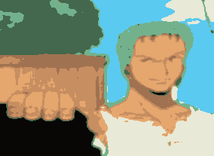

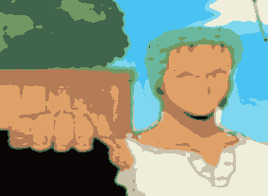
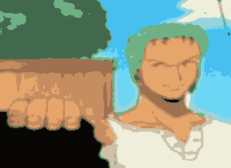
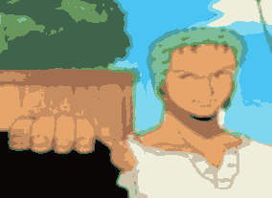
We can run a range of k values and graph the result
centroid neighbor distance avrg
zoro.png
K (# of colors)

Slide 11
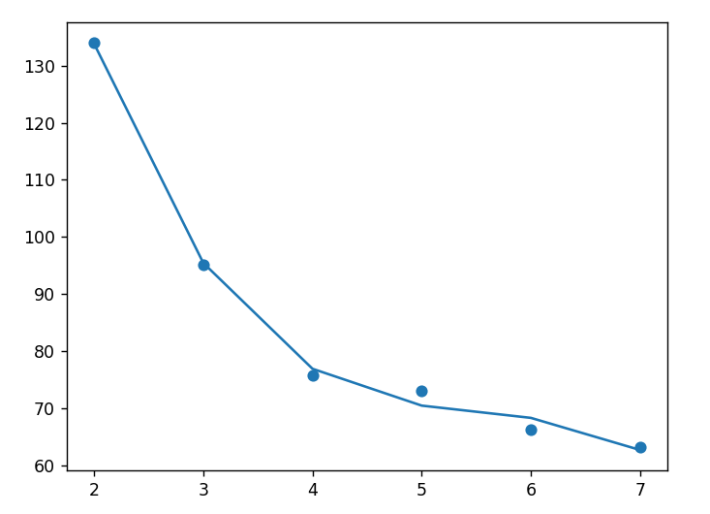
eric.png
centroid neighbor distance avrg
K (# of colors)

Slide 12
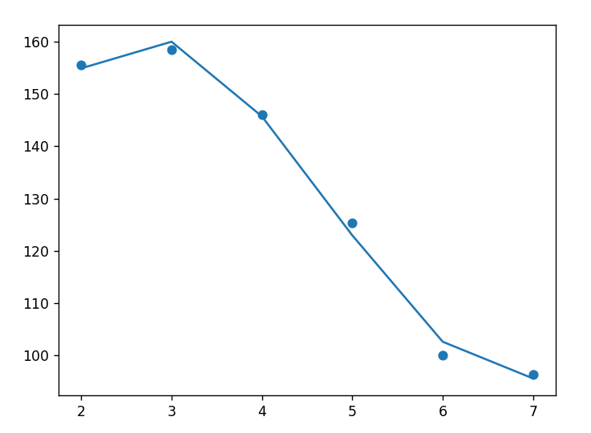
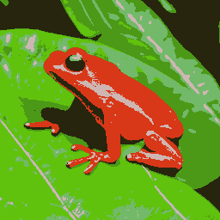
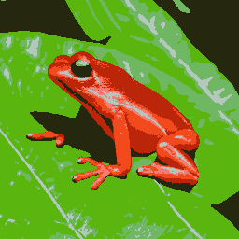
frog.png
centroid neighbor distance avrg
K (# of colors)

Slide 13




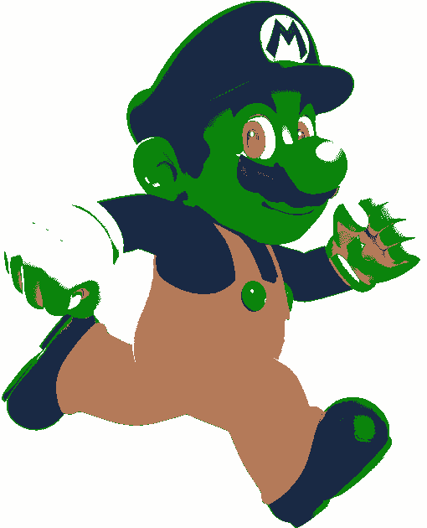
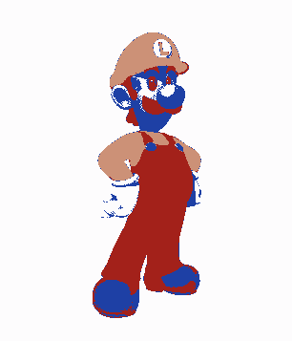
We can also swap the centroids between images
Palette swap
Colors swapped based on how many colors are in each centroid’s cluster
Still based on nearness to original centroid, not swapped on

Slide 14
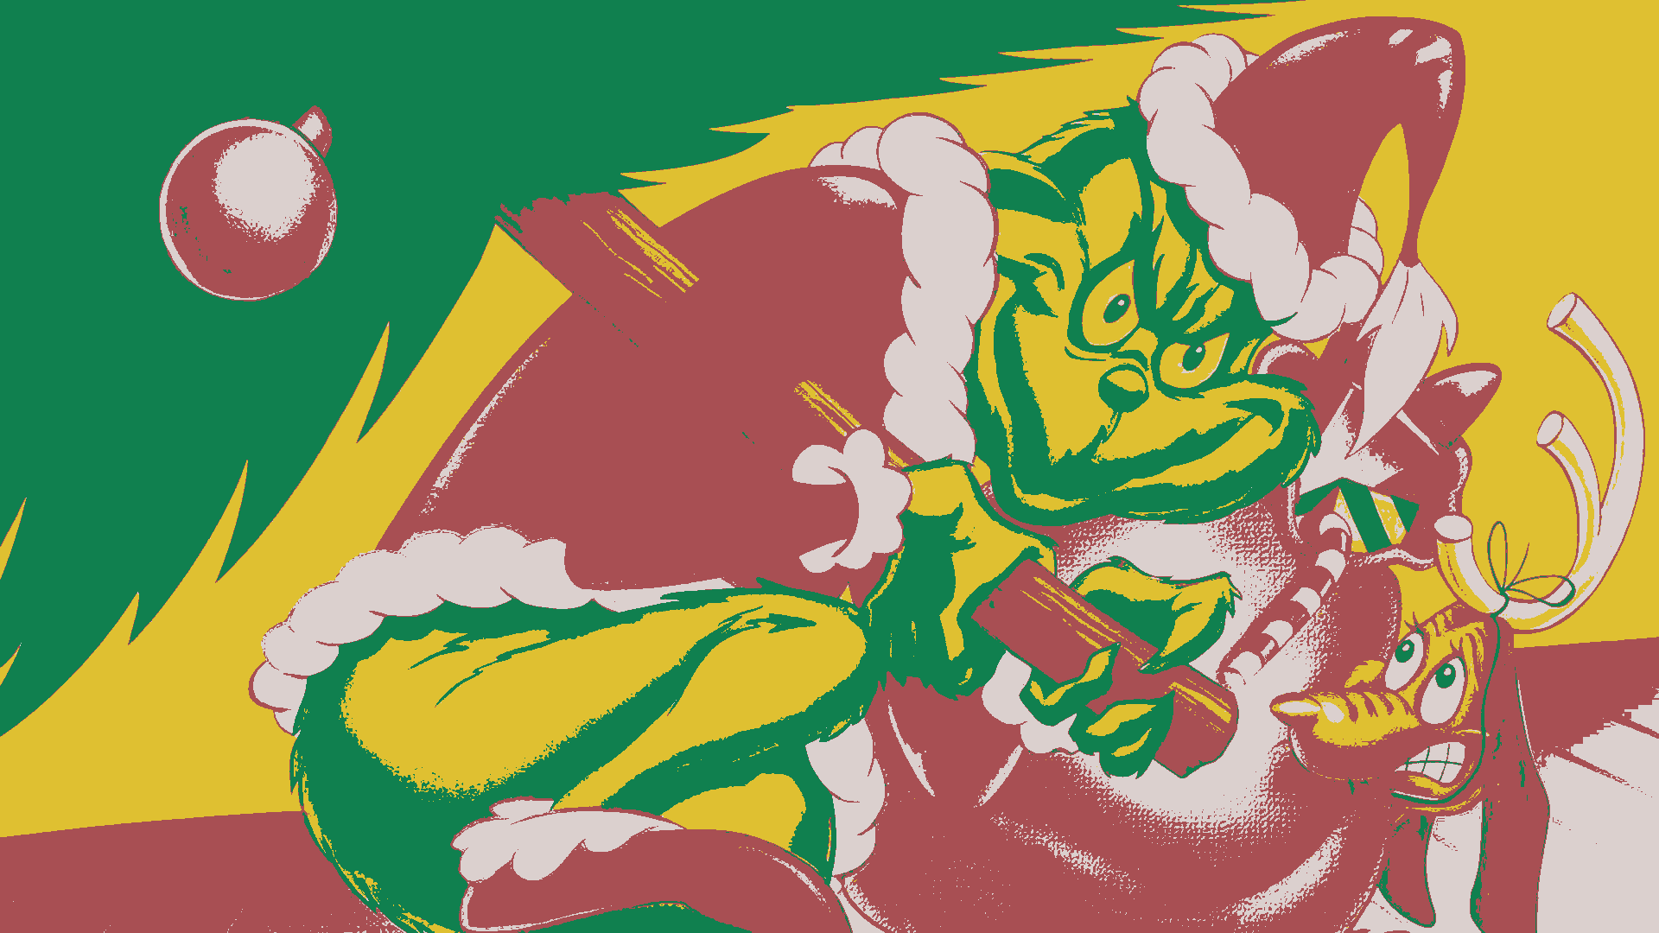
Special thanks to Dr. Hansen’s slides and the NumPy documentation
Merry Christmas

